Slide 1
IMSI-Catchers: Still relevant in the 5G context?
DLarisa

Slide 2
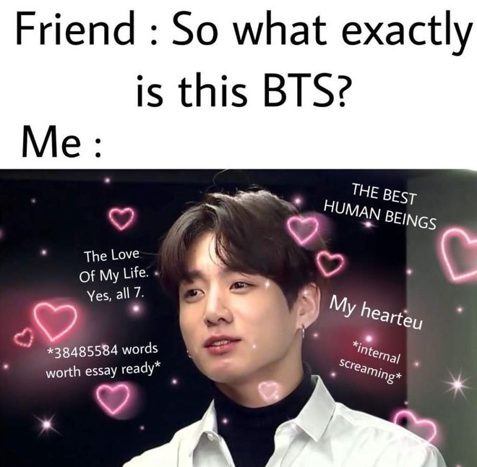
General Information
User Equipment(UE)
Base Transceiver Station(BTS)
Example: smart-phones
Has a Universal Subscriber Identity Module Card (USIM)
SUPI: Permanent Identifier (4G: IMSI)
SUCI: Concealed Identifier (SUPI + Elliptic Curves Encryption)
GUTI: Temporary Identifier
Forwards data between UE and the core network.
Core Network
Handles authentification and key agreement.

Slide 3
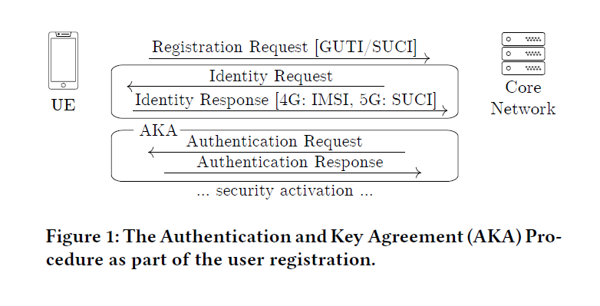
Device Registration and Authentication
https://www.syssec.ruhr-uni-bochum.de/media/emma/veroeffentlichungen/2021/06/02/5G-SUCI-Catcher-WiSec21.pdf

Slide 4
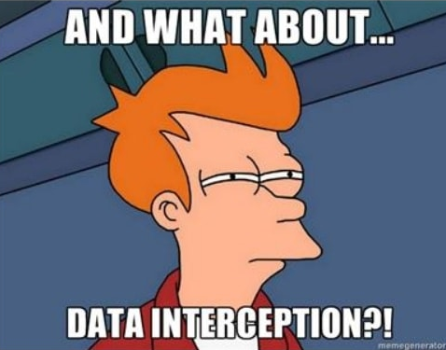
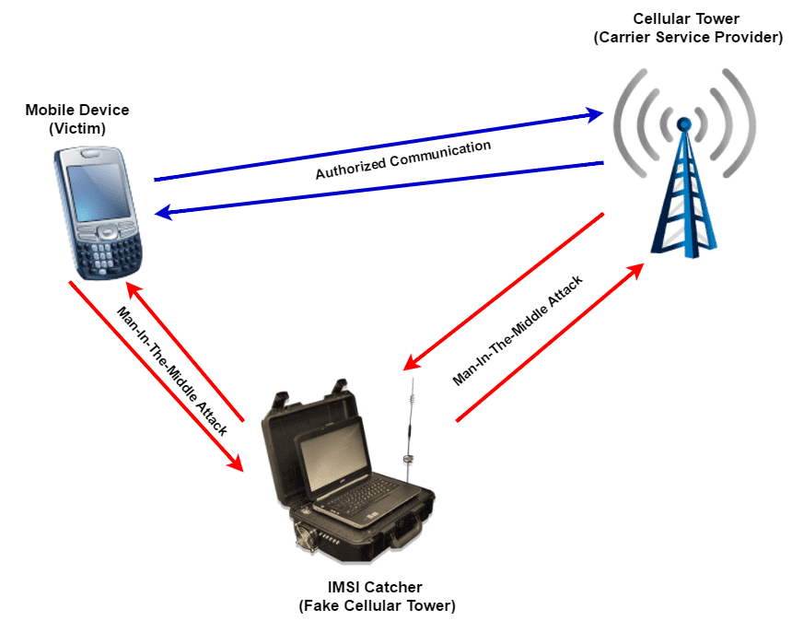
IMSI (SUCI) Catchers
IMSI catchers are primarily used for the following reasons:
Spyware delivery: Some high-end IMSI catchers can deliver spyware to the target device. The spyware provides RAT (remote access trojan) capabilities such as ping the target location directly and also transfer audio/text/images) through the device.
Data Extraction: Capture metadata such as calls made (A party, B party), call duration, date/time of call, including contents of unencrypted calls/text, and even data usage (sites visited).
Data interception: Some IMSI catchers advertise the ability to divert calls and text messages, edit messages and spoof the user’s identity in calls and text messages.
Location tracking: IMSI catchers can force a target UE to respond to a precise location using GPS, or using the signal strength of towers, allowing the use of triangulation to accurately pinpoint user location.

Slide 5
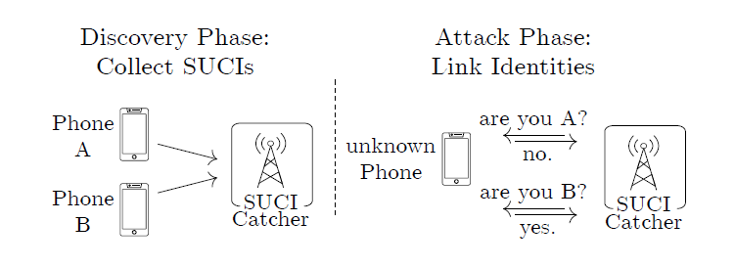
SUCI-Catcher Attack
https://www.syssec.ruhr-uni-bochum.de/media/emma/veroeffentlichungen/2021/06/02/5G-SUCI-Catcher-WiSec21.pdf

Slide 6
1) SUCI-Catcher Attack: Discovery Phase
a) Obtaining A SUCI via 5G
b) Deriving SUCI from IMSI
The attacker can sniff network traffic for a SUCI or actively request it once the user connects to the fake 5G base station.
If the IMSI is known, the attacker can perform the encryption from IMSI to SUCI since the operator’s public key is known. The IMSI can be obtained with 4G IMSI catching, which will remain possible as long as the phone supports 4G.

Slide 7
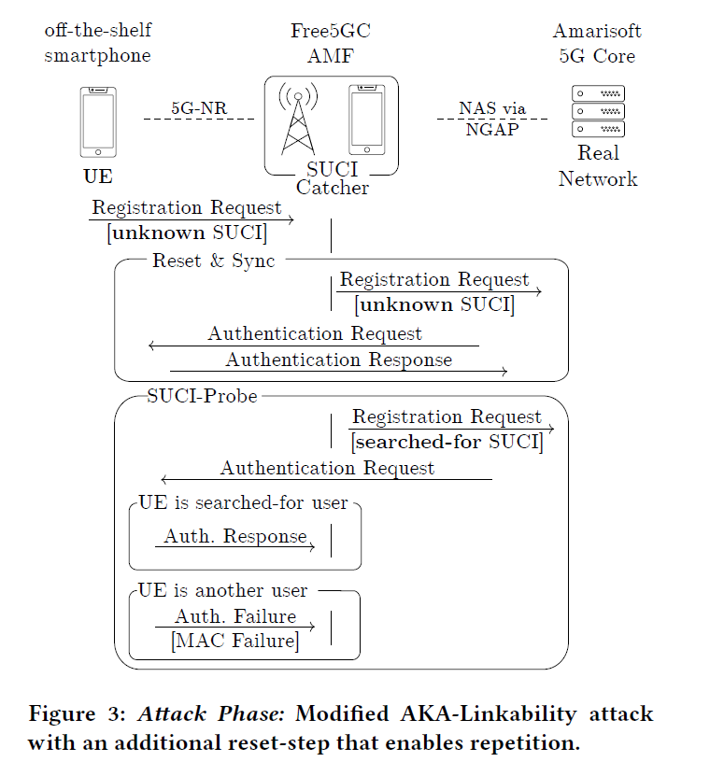
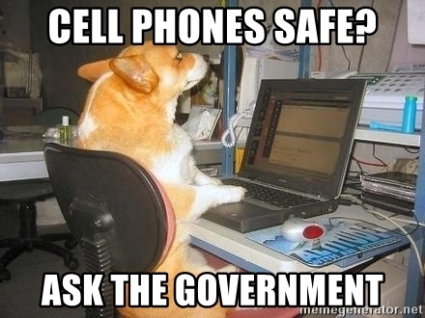
2) SUCI-Catcher Attack: Attack Phase
https://www.syssec.ruhr-uni-bochum.de/media/emma/veroeffentlichungen/2021/06/02/5G-SUCI-Catcher-WiSec21.pdf

Slide 8
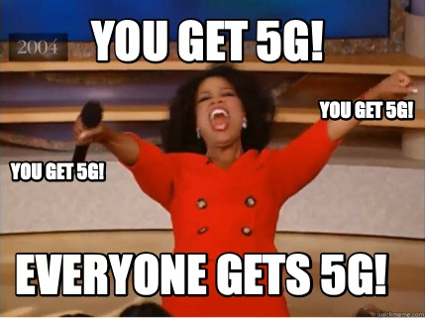

Thank You!

Slide 9

Resources
https://www.syssec.ruhr-uni-bochum.de/media/emma/veroeffentlichungen/2021/06/02/5G-SUCI-Catcher-WiSec21.pdf
https://5ghub.us/subscriber-privacy-in-5g-network/
https://www.5gfundamental.com/2021/02/5g-guti-supi-suci.html
http://5gblogs.com/concealing-of-supi-into-suci/
https://www.drsuresh.net/2021/06/5g-suci-catcher/

